Slide 1

Immune Receptor Profiling Nanocourse: Session 1- Data Digest
Organized by the VDJServer Team
June 1, 2018
UT Southwestern Medical Center

Slide 2
AGENDA
8:45am – 9:00am Setup, Registration, provide workshop handouts to participants
9:10am – 10:30am Introduction session
9:10am – 10:30am: Immune system overview (including immune sequencing technology and summary of vdjserver workflow for analysis); Setup IgBlast jobs with demo files
Show slides and video
10:30am-10:40am Break
10:40am – 11:45am Session 1- Data digest
Demo data and VDJServer hands-on demonstrations
Elaborate on the functionalities and benefits of VDJServer such as: no need to install anything, reproducibility, easy to use, data is stored on your account and is private, collaborative sharing of data, and long term archiving.
Breakout and setup RepCalc VDJServer “jobs” (provide one-on-one assistance and point participants to quickstart protocol @ handout pages)
11:45am – 1:00pm Lunch
1:00pm – 2:40pm Session 2- Community standards, Data analysis and interpretation
Example of pre-processing using FASTQ files
AIRR Standards
Analysis and interpretation of repertoire calculations output
2:40pm-2:55pm Break
3:00pm-3:45pm
Downstream application of VDJServer products in machine learning (example dataset using the demo dataset and discussion of some outcomes)
3:45pm-4:15pm
Summarize the workshop and encourage future interactions
Invitation to use some example datasets for further analysis (VDJServer team will assist in setup as time permits)

Slide 3
Session 1 objectives
Setup RepCalc VDJServer “jobs” (provide one-on-one assistance and point participants to quickstart protocol @ handout pages)
Demo data study overview
VDJServer workflow demonstration of metadata and VDJ assignment
Explore IgBlast web application with demo sequences
Review of output files from IgBlast jobs
Functionalities and benefits of VDJServer as a community resource

Slide 4
Creating your project space-
Key Steps: 1) upload read level data files 2) upload metadata
Notes:
Fasta files used earlier for IgBlast (refer to screenshot)
Metadata files (live demo; see templates in handouts)
IgBlast application (quick web demo with 3 sequences and look at results)

Slide 5

Setup RepCalc job

Slide 6
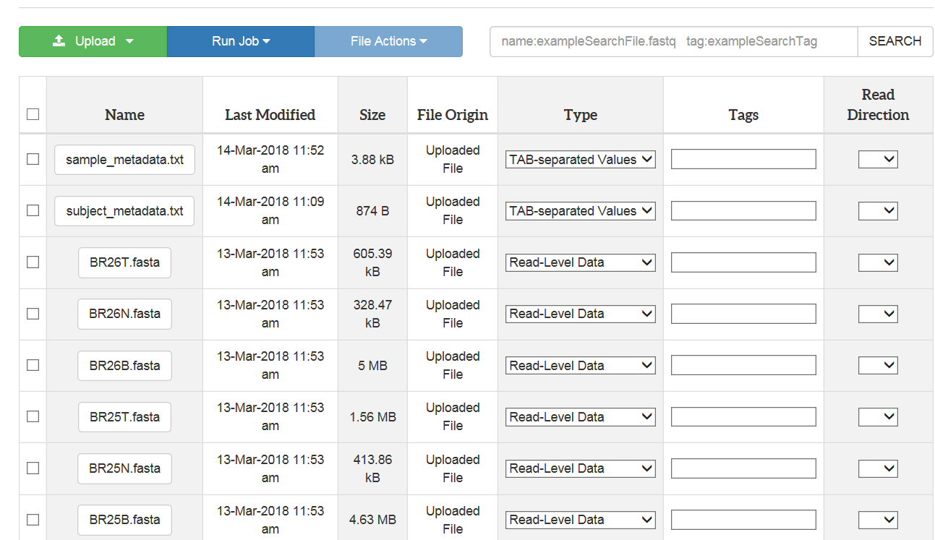
Fasta files from study

Slide 7
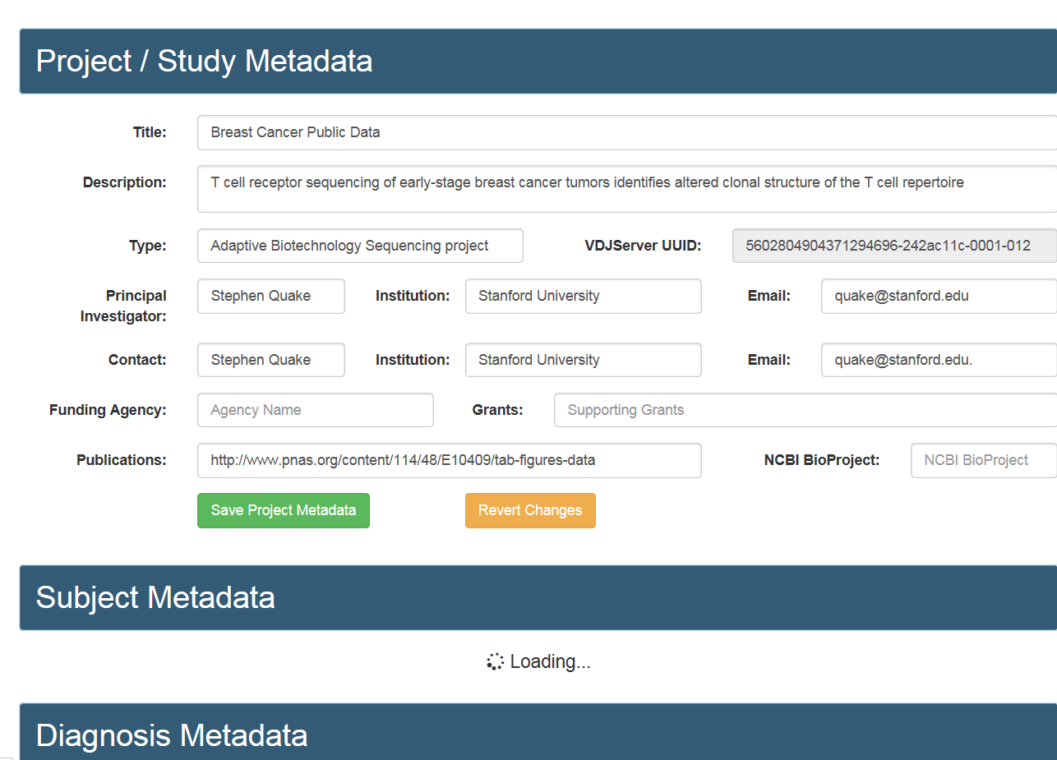
Metadata
Notes:
Sample group selection for metadata (show screenshot)

Slide 8
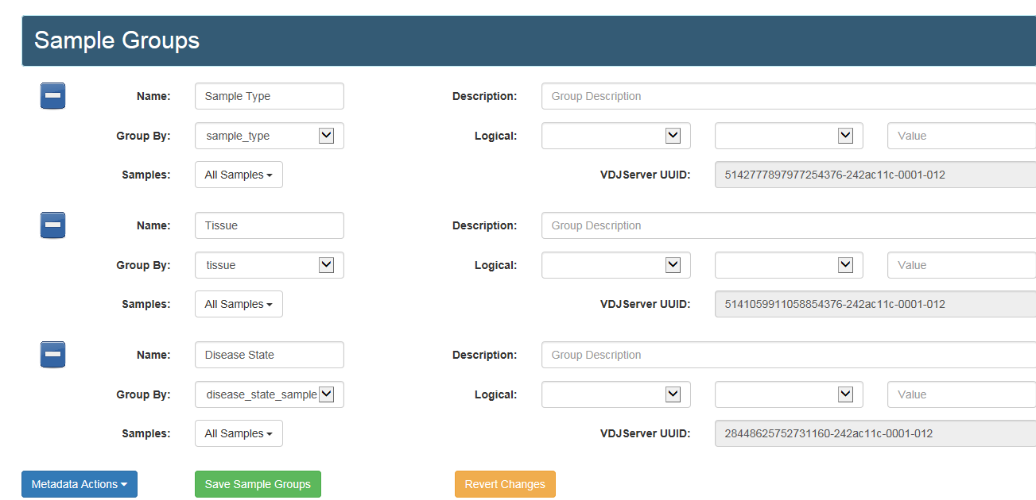
Selecting sample groups

Slide 9
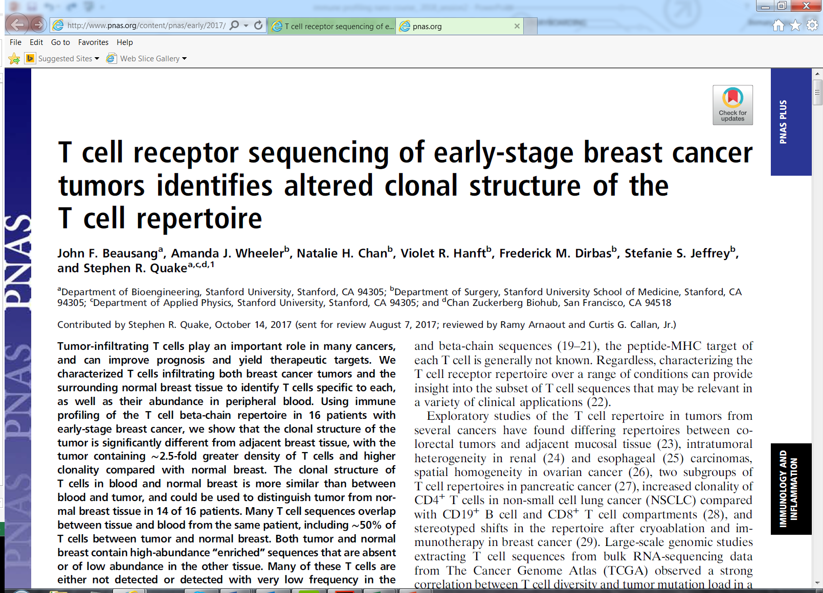
Demo data study overview

Slide 10
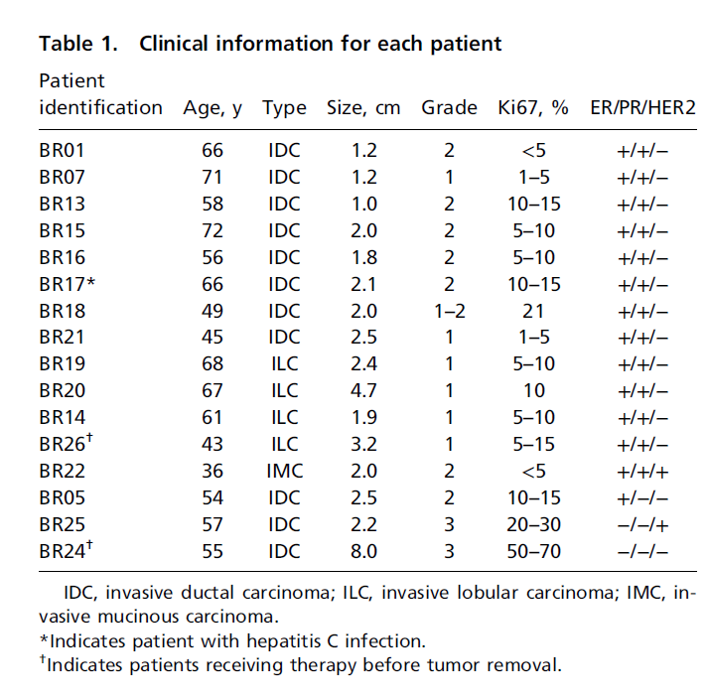
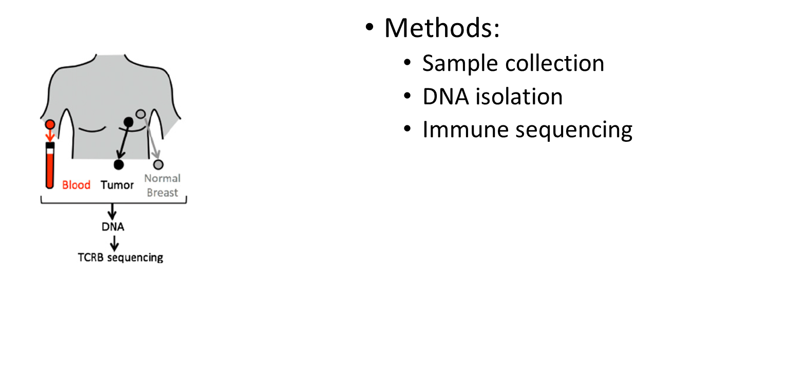
Background: study population and samples collected

Slide 11
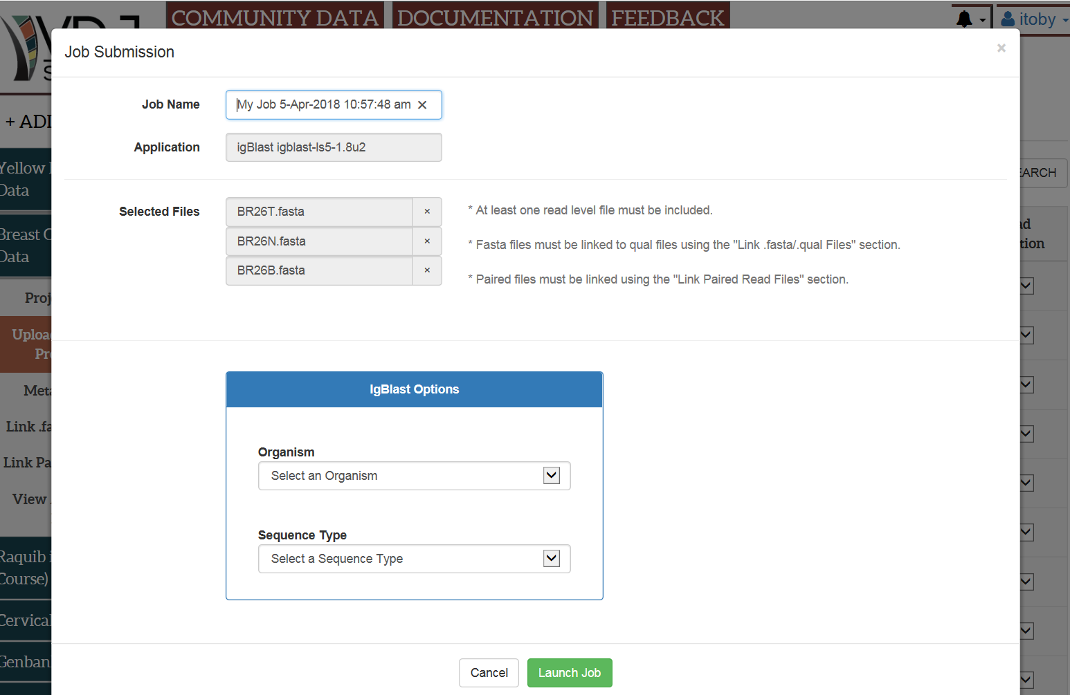
Submitting the IgBlast job

Slide 12
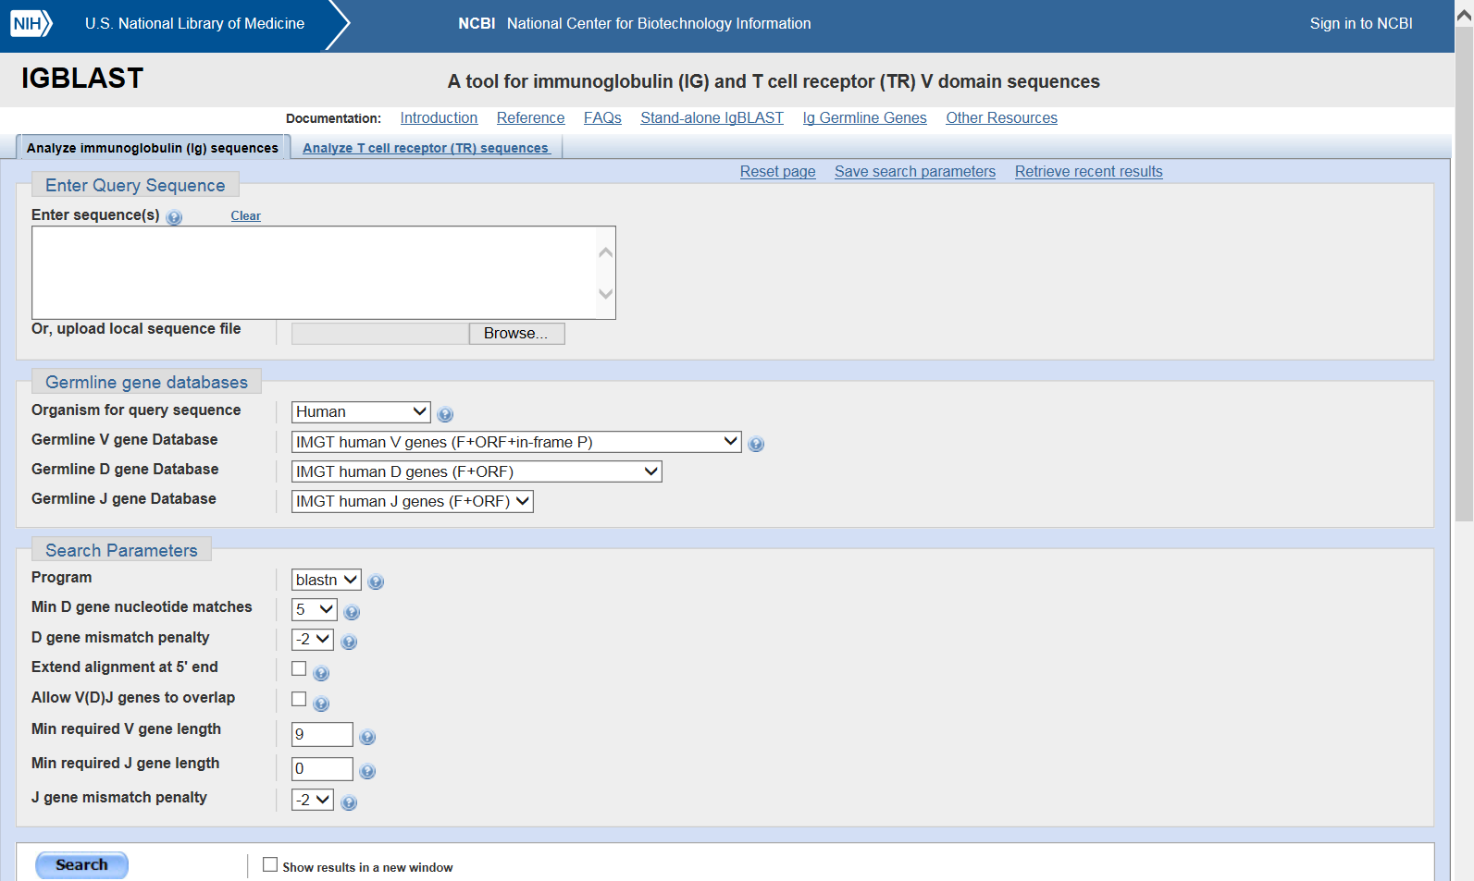
IgBlast web application
https://www.ncbi.nlm.nih.gov/igblast/

Slide 13
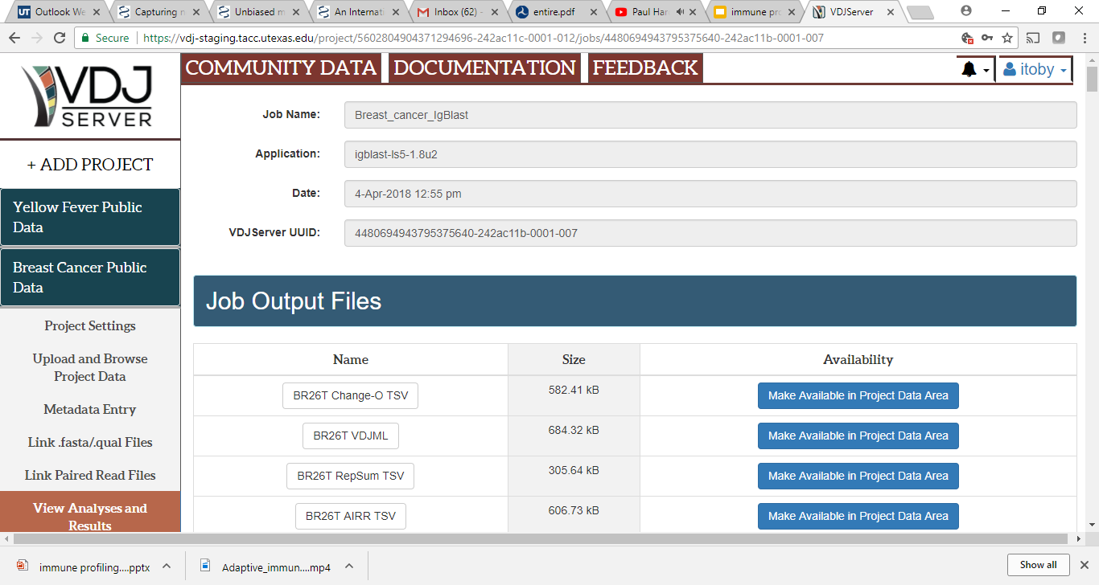
Review and Discussion of output files from IgBlast

Slide 14
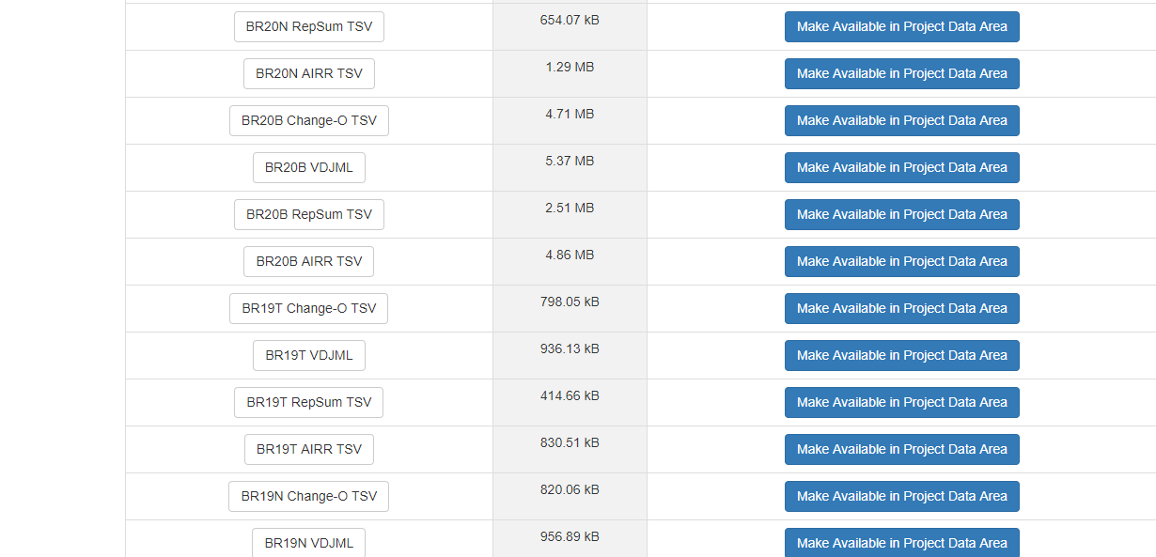
Review of IgBlast output files

Slide 15
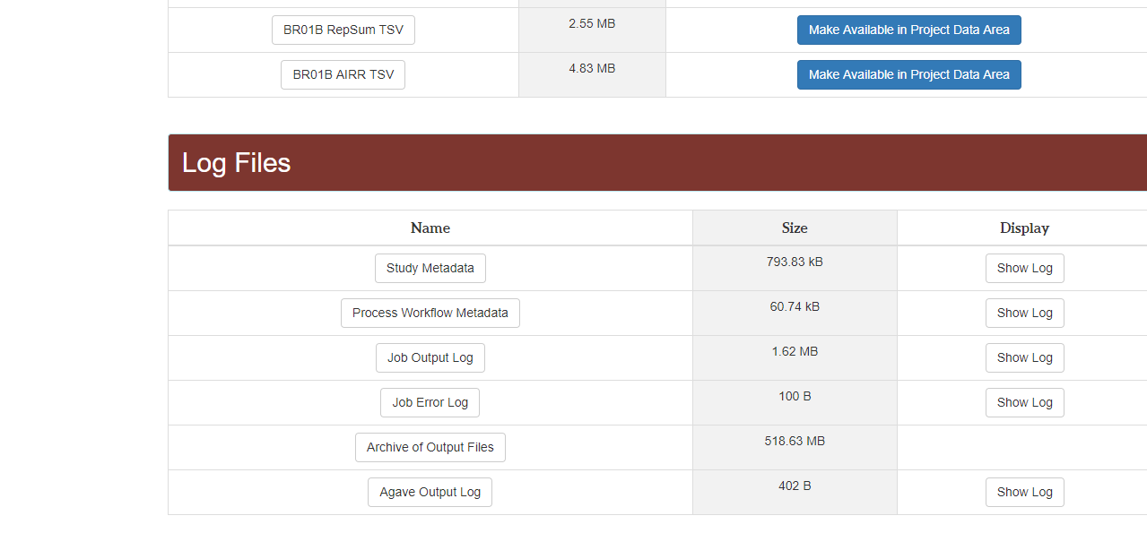
Review of IgBlast output files
Notes:
*Job error log review: participants can check show log to view any issues that arise
Archive of output files review

Slide 16
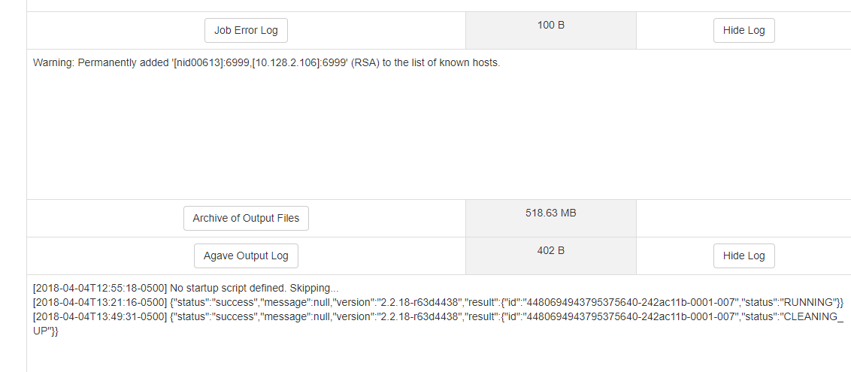
A look at the log files provided on VDJServer (How to use these and reference them when needed)

Slide 17

Benefits of VDJServer
There is no need to install anything
Workflows promote reproducibility
Applications are provided via the GUI making it easy to use
All data is stored on your account and is private
There is no need to batch submissions; full files from entire study population can be uploaded and processed
Web portal supports collaborative sharing of data and long term archiving

Slide 18
Next: items for session #2 (after lunch)
Pre-processing steps using Fastq files (use case from demo data provided)
MiAIRR Standards (overview of steps involved and approaches to fulfill these for publication purposes)
Analysis and interpretation of data from repertoire calculations for breast cancer demo data

